Slide 1
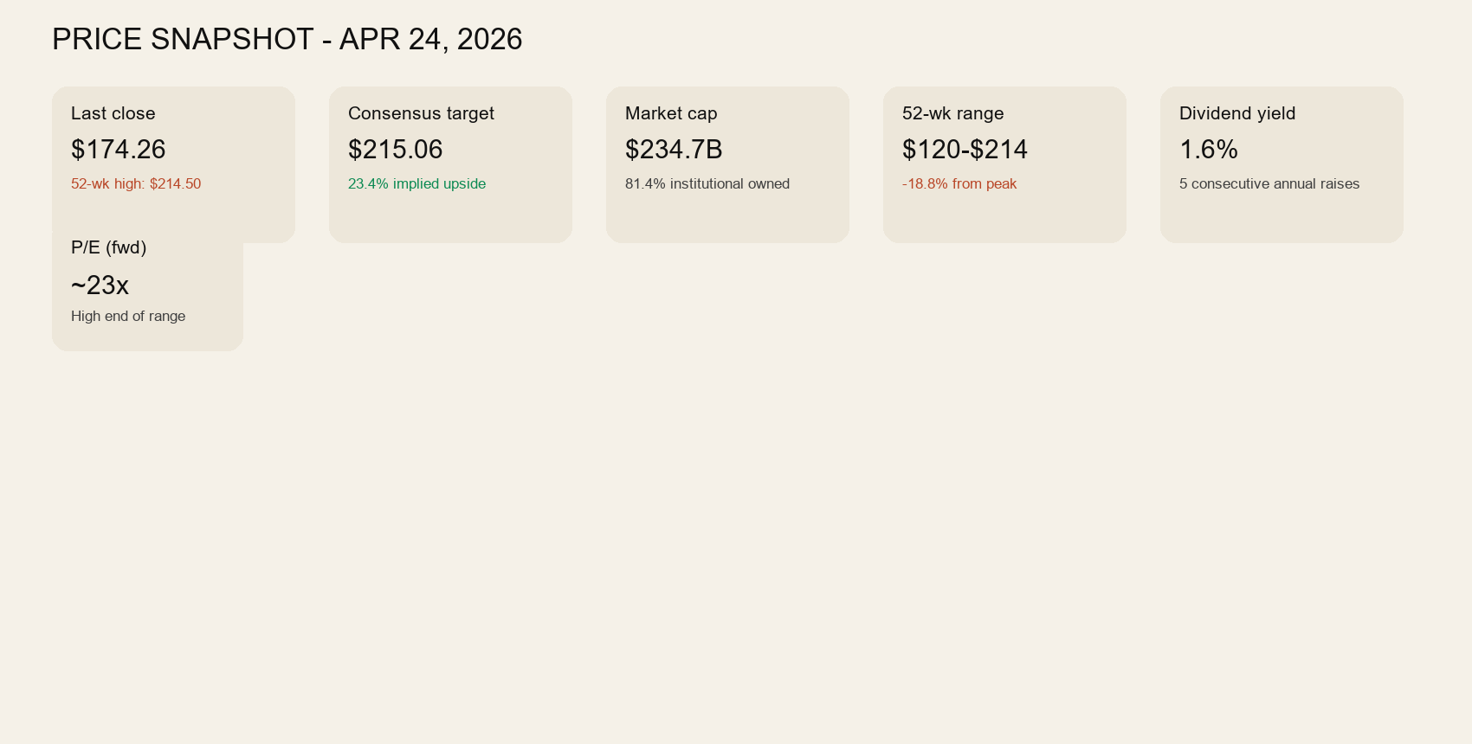
RTX Corporation (NYSE: RTX)
Visual investment deck | Generated from Veritas report assets
Q1 execution was solid and guidance improved
Analysts still see upside
Chart remains weak
Current stance: bench until repair

Slide 2
Executive Summary
What matters now
Close
$174.26
52-wk high $214.50
Consensus target
$215.06
22 analysts
Current stance
Bench
Wait for repair
Solid quarter, stronger guide
Backlog remains supportive
Analyst view is constructive
Technical picture is still the blocker
Do not force deployment
Business: credible
Quarter: supportive
Chart: weak
Action: patience
Upgrade path: repair + reclaim

Slide 3
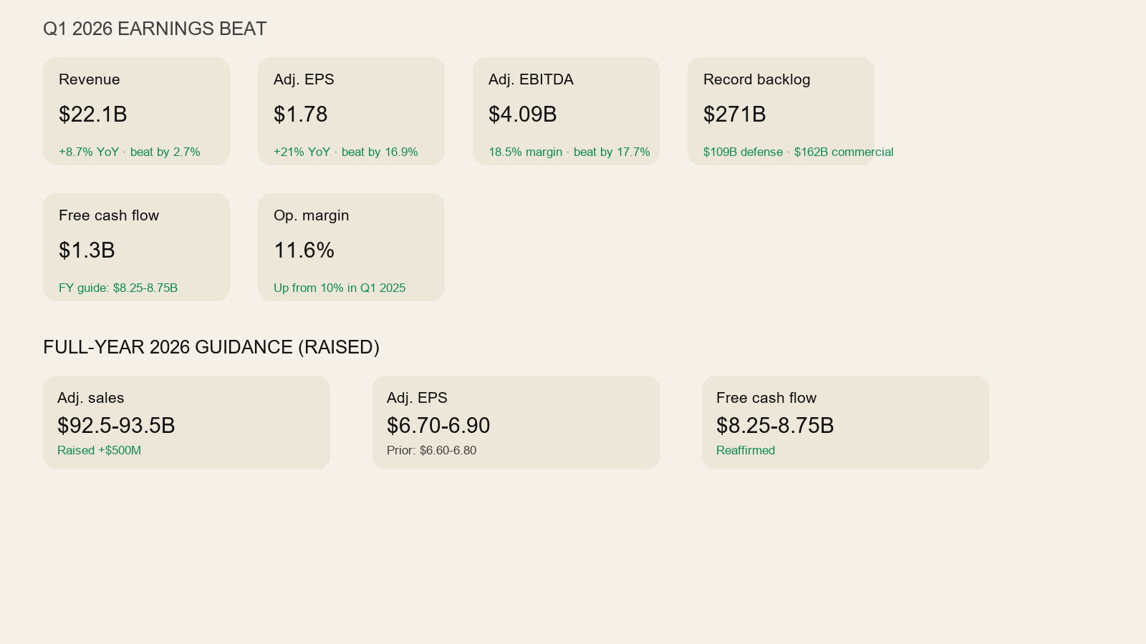
Q1 2026 Results and Guidance
Strong quarter, but not enough to override weak structure
Revenue, EPS, EBITDA, and backlog all support the business case
Guide improved, but price still has not confirmed

Slide 4
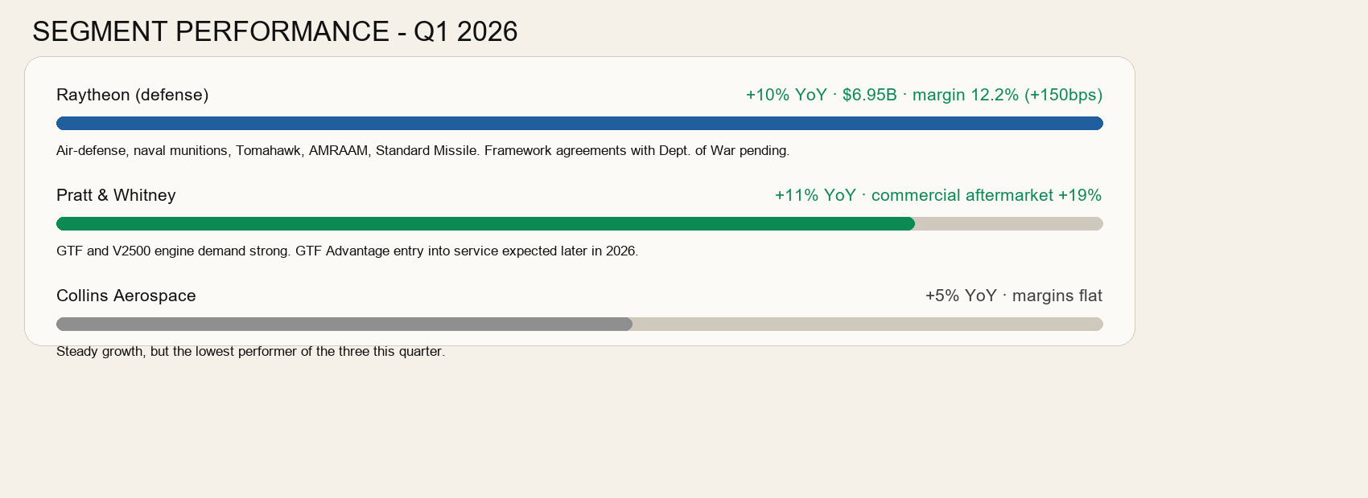
Segment Performance
Where the quarter was strongest
Raytheon and Pratt & Whitney led the quarter
Collins remained positive but softer

Slide 5
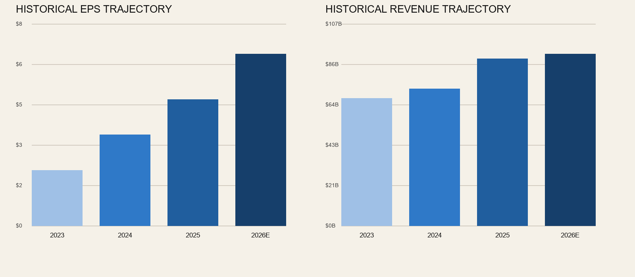
Historical Financial Trend
Revenue and EPS trajectory
Business trend is improving
The problem is timing, not legitimacy

Slide 6
Technical and Portfolio Read
Why the business can be fine while the stock is still a no
20D / 50D / 200D
193.9 / 199.1 / 178.1
Price remains below all three
Support / resistance
174.3 / 203.5
Recent range still weak
Action
Bench / no action
Wait for technical repair
Below 20D, 50D, and 200D
That is weak posture, not constructive posture
Good guidance does not override bad timing
Upgrade only after support repair
Then reclaim moving averages
Then define entry and invalidation

Slide 7
Risks
What can still go wrong
Execution risk
Supply-chain and program risk
Chart weakness can trap capital
Analyst upside can stay theoretical
Defense theme does not guarantee entry quality
Post-earnings tape still needs repair
Better setups elsewhere raise opportunity cost

Slide 8
Decision Slide
Bottom line
Verdict
Bench
Not a force-buy
Upgrade trigger
Repair + reclaim
Support base plus MA improvement
Downgrade trigger
Fresh breakdown
Continued weakness below recent lows
Credible company
Supportive quarter
Weak chart
Correct posture: patience
Do not force capital
Wait for technical repair
Use price, not persuasion

